Slide 1
Genba Sopanrao Moze College Of Engineering Balewadi, Pune.
Department of MCA
Group ID : PBL- 17
MCA II SEM
Project Name : Blood Bank Management System
Presented By : KASHID JIVRAJ BAPURAO
KUMBHAR SUMIT TANAJI
MASTER OF COMPUTER APPLICATION
2023-2024

Slide 2

AGENDA
Introduction
Overview of Project
Modules of Project
E_R diagram
Database Design /Tables
Use case Diagram
Activity Diagram
Screen Designing
Status of Working Demo

Slide 3
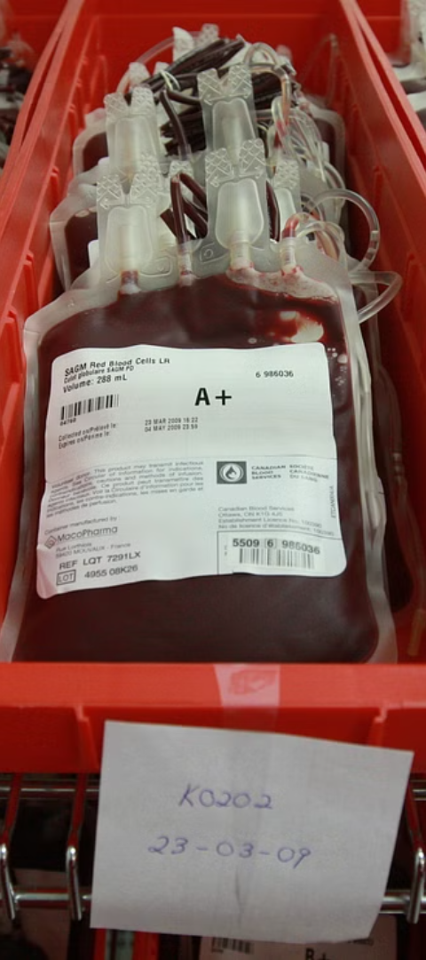
INTRODUCTION
- Welcome to the presentation on the Blood Bank Management System.
- Purpose: This project aims to streamline the process of managing blood inventory and donor information in blood banks.
- This Blood Bank Management System is actually a stand alone application. Developed using Java, the system provides an efficient solution for blood banks to maintain records, manage donations, and facilitate blood requests.
-The aim of this Blood Bank Management System project is to build a system that will able to Automate many operations in a Blood Bank.

Slide 4
OVERVIEW OF THE PROJECT :
1. The main objective of the project is to design and develop an efficient computerized Blood Bank Management System Storing the details of customers.
2. Storing the details of Blood.
3. Maintaining and updating Patient details
4. To provide better graphical user interface.
5. Selling and Buying blood is possible.
6. Computerization can be helpful as a means of saving time and money.
7. This system is developed using java(swing) technology and MySQL as backend to store data.

Slide 5
Modules of Project :
Admin Module:
User Management: Enables the admin to add, update, or delete user accounts (staff members).
Dashboard: Provides an overview of key metrics such as blood inventory levels, recent donations, and pending requests.
Reporting: Generates various reports for blood inventory, donor records, and transaction history.
2. Donor Management Module:
Registration: Allows new donors to register by providing their personal information, contact details, and blood type.
Search Functionality: Allows staff members to search for donors based on criteria such as blood type, location, and availability.

Slide 6
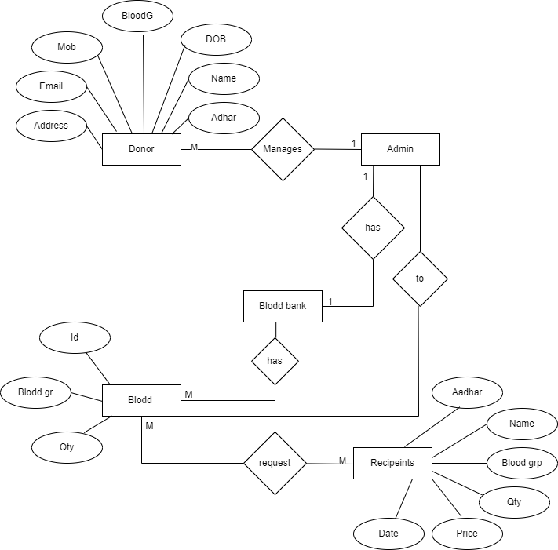
ER-Diagram :

Slide 7
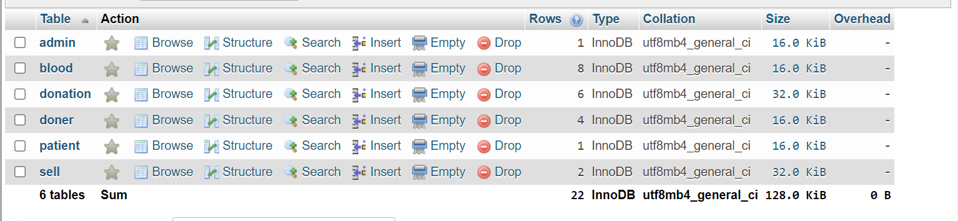
Database Tables :

Slide 8
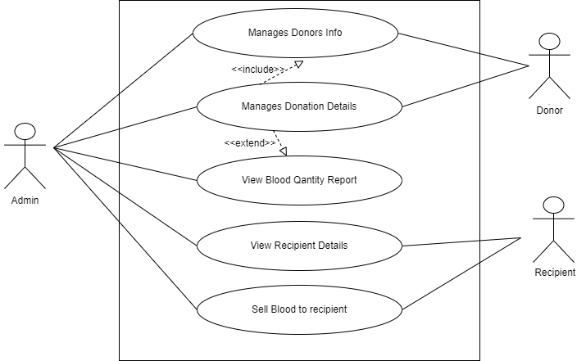
Use-Case Diagram

Slide 9
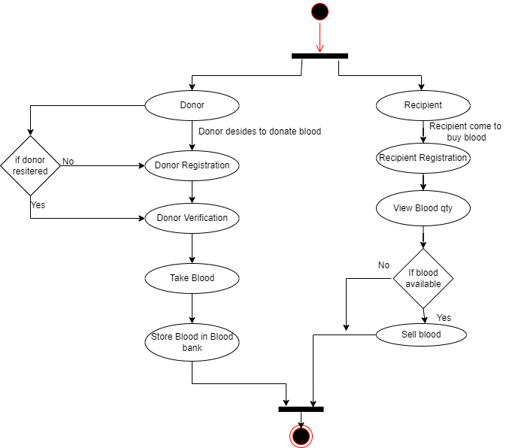
Activity Diagram :

Slide 10
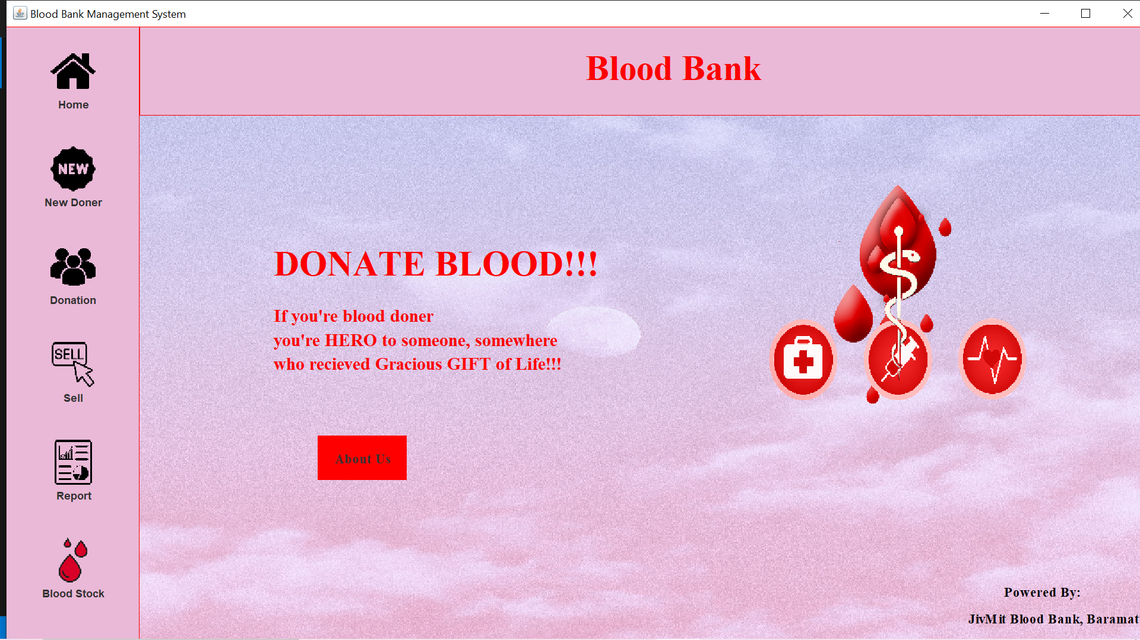

Slide 11
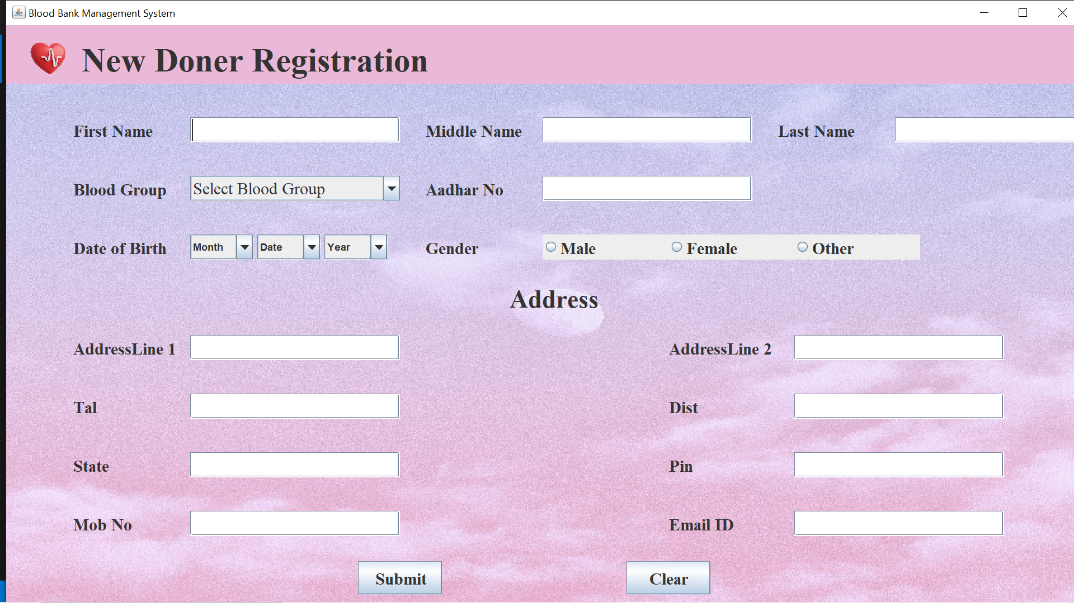
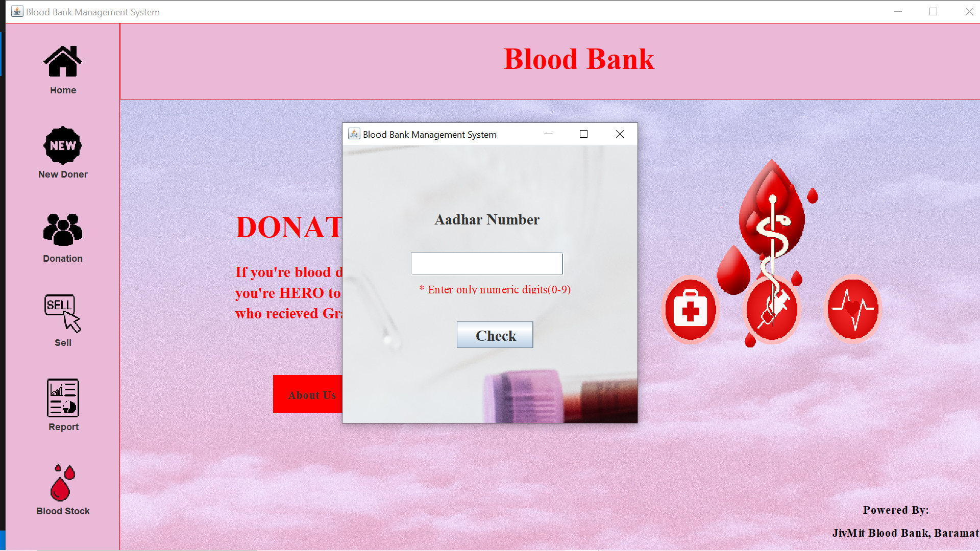
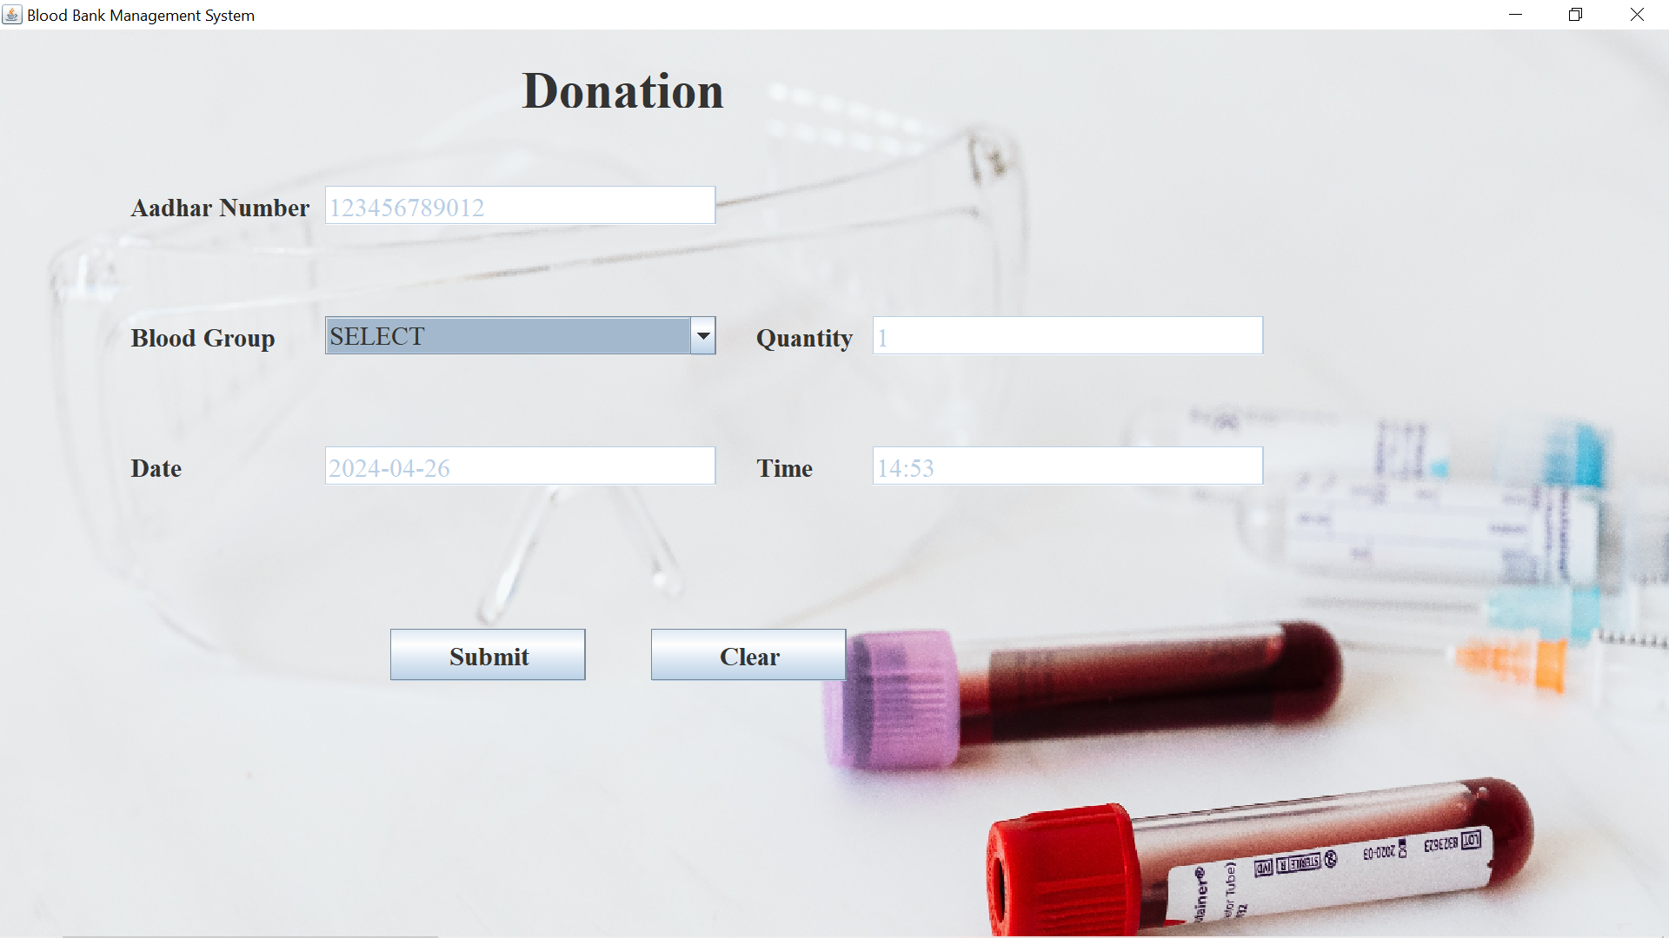
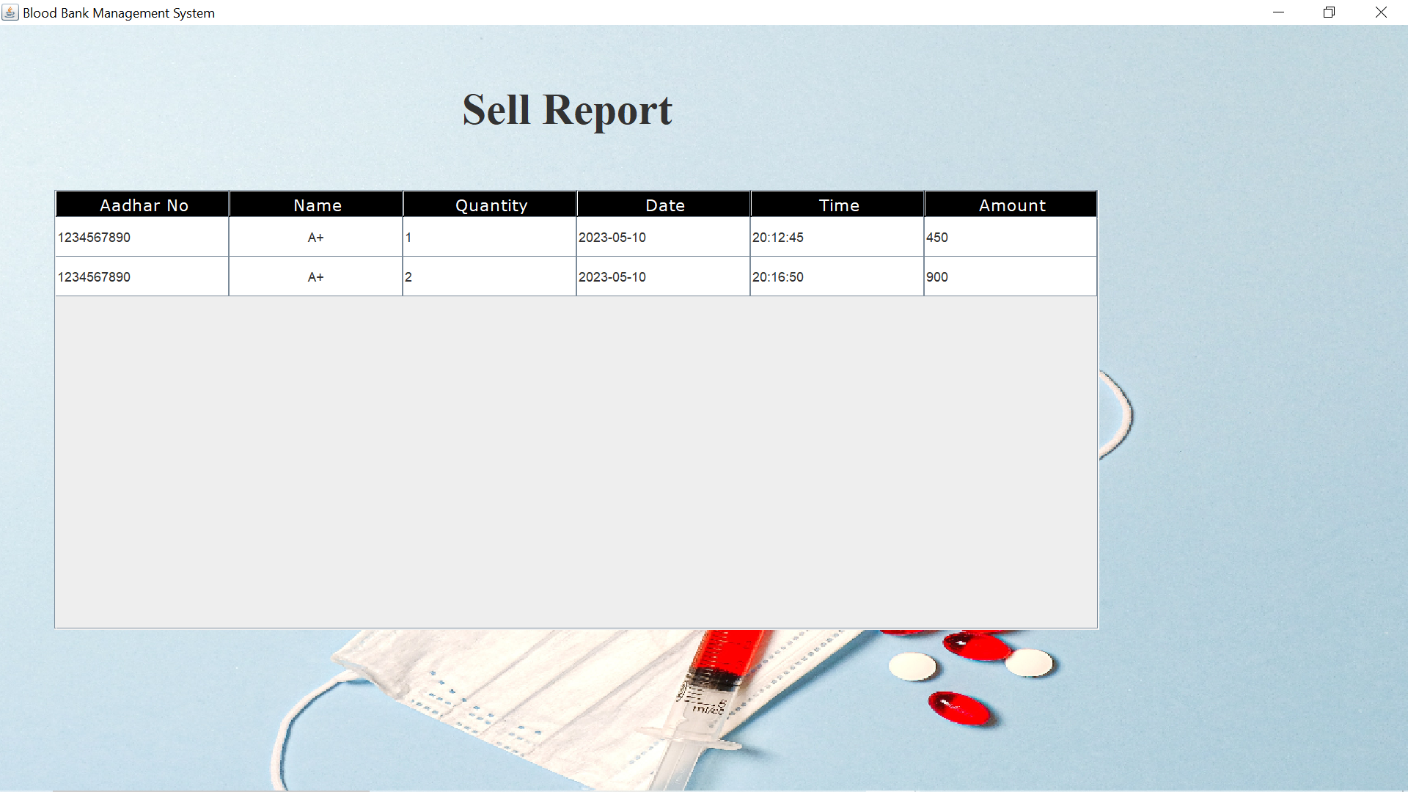

Slide 12
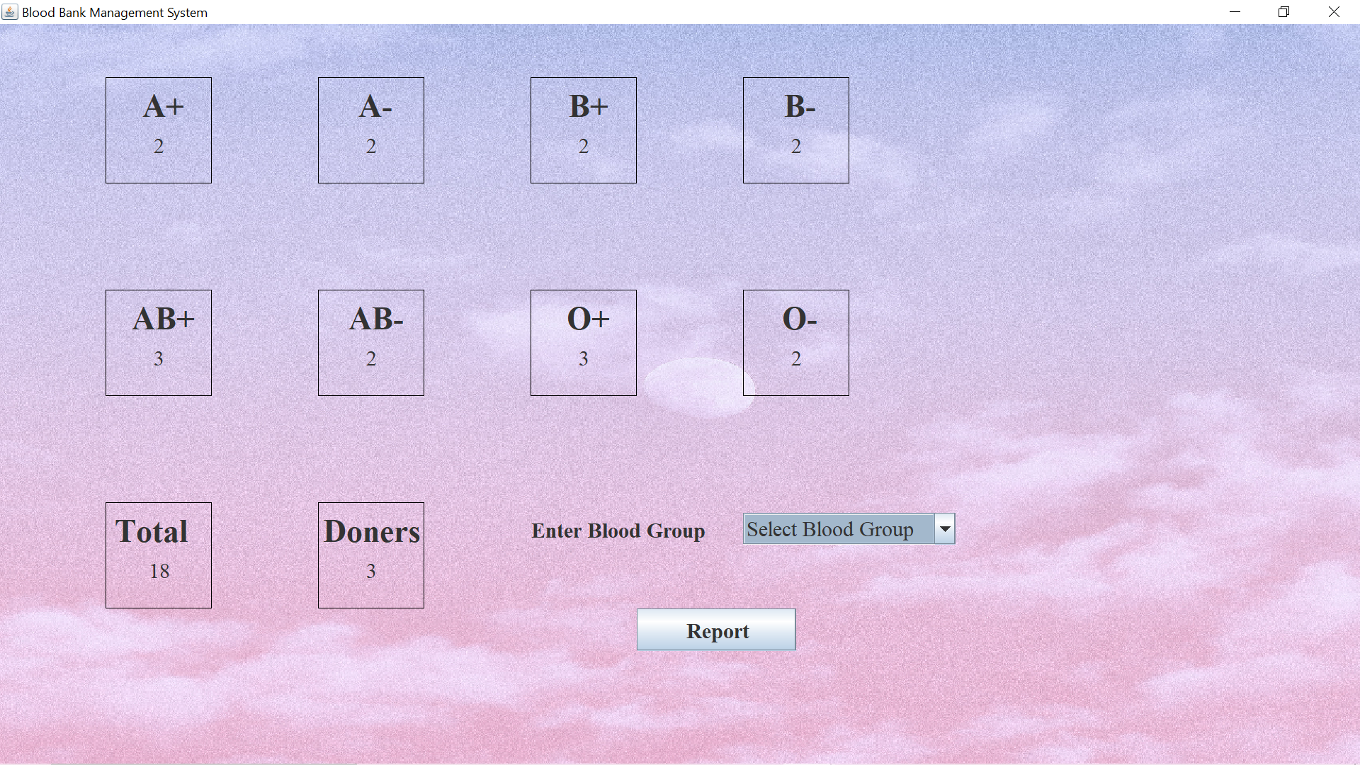

Slide 13
Status of Working Demo :
Completed Tasks:
Design and implementation of Admin Module
Integration of MySQL database with Java Swing application
Development of Donor Management Module
Implementation of Blood Inventory Management Module
User interface design for key screens
Testing and debugging of core functionalities
Pending Tasks:
Implementing validation for user input in Donor Management Module
Adding error handling for database operations
Enhancing user interface for better user experience
Conducting comprehensive testing to ensure system reliability and security

Slide 14
THANKYOU

